Slide 1
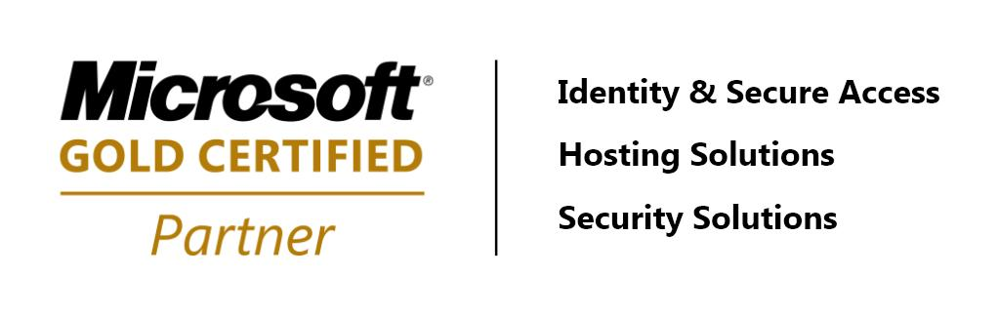
How Do I Know My Data is Safe?
Data Security – Issues and Strategies
Joe Rainero – NetTec NSI

Slide 2

What is Your Data?
Electronic Documents: files like Word documents, Excel spreadsheets, photos, music, drawings, trade secrets, recipes, etc.
Electronic Communication: e-mail, instant messages, text messages, web pages, drivers license, credit card information, account information, addresses, phone numbers, mother’s maiden name, etc. (information that can and will be used against you.)

Slide 3
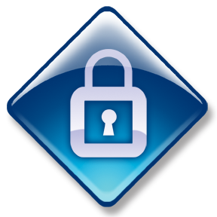
What is “Safe”?
Will be there when it’s needed.
Secure
Available only to those with authorized access.
Recoverable
Can be restored after a disaster.
Available
Strategy: Secure Data by Controlling Access.

Slide 4
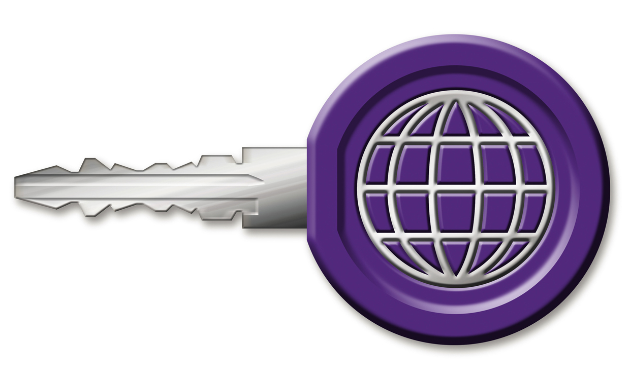
What is Access?
Access = Control
Computers control this with ACLs – Access Control Lists - Who can do what to what?
Security Tab in Windows
  It tells who has what permissions: Full, Delete, Write, Read
There is more to access than ACLs:
  Physical: data on your computers
  Network: data in transit.
  Remote: data stored on the Internet, or across a network like websites, servers, devices out of your control.
Think about points of access…where is your data? Then think about applying controls.

Slide 5

Where Is Your Data?
Desktops
Home Devices
Company Servers and Backups
Mobile Devices
Web Sites
Laptops
E-mails
Text Messages
Instant Messages
Thumb Drives
It’s Everywhere.
Find it to protect it.
Data moves around
and has resiliency.

Slide 6

Data Has Resiliency.
Who really believes you have privacy?
Today’s technology makes it possible to discover anything you do online.
Just deleting e-mails, browsing history and text messages doesn’t really remove the evidence.
  What information is kept by?
    My ISP = IP addresses.
    Google Searches = reports of up to 7 years.
    Facebook = cached pages, Way Back Machine.
Key: In creating data, only do what you want the whole world to know you’ve done because the whole world can know what you’ve done.

Slide 7

Who Has Access to My Data?
Systems You Control – Home PC, Mobile Phone
  Kids
    Windows media sharing and iTunes from game consoles.
  Housekeeper
  Baby Sitter
  Parents – aka your kids’ grandparents
  Neighbors
    Wi-Fi
Systems You Use – Work PC, Kiosk, Work Phone (resiliency)
  Co-workers
  Administrators
  Boss
  Web designer/host
  Websites - Facebook, web based e-mail
  Vendors
    Does your business give remote access to vendors?
    What do they have access to?
Key Points:
  A compromised system gives access to anyone.
  Physical access gives complete control. With enough time and the right tools, any security can be compromised.
  Think about what kind of data you want hanging around for anyone to access.

Slide 8
Where Is Your Data?
Specific Strategies
Desktops
Home Devices
Company Servers and Backups
Mobile Devices
Web Sites
Laptops
E-mails
Text Messages
Instant Messages
Thumb Drives
Secure Passwords
ACLs on File Sharing
Store on Trusted Systems
Remote Wipe
Generic Data
Encrypt
Public
Public
Public
Limit Use
It’s Everywhere.
Find it to protect it.
Data moves around and has resiliency.

Slide 9

Strategy: Secure Data by Controlling Physical Access.
Employ strategies to discourage attacks.
Traditional locks, security alarms, monitoring.
Carefully choose to whom you give access and use the Principle of Least Privilege: separate user accounts, ACLs, in Windows use limited accounts vs. administrator accounts.
Bit locker (drive encryption) especially for thumb drives and laptops.
Limit failed logon attempts.
Password protect your data and secure your passwords.
  Control Panel/Users
  Don’t give them out.
  Don’t write them down.
  Use a screen saver with a password.
  Lock your computers using.  +L
  When creating a password, create a phrase that only you know and you won’t forget; make it simple to remember, hard to guess.
Protect systems once they’re out of your control
  Auto-wipe and remote-wipe.
  Clean devices before turning over control – laptops, phones, etc.

Slide 10
Strategy: Secure Data by Controlling Network Access.
Reality – no system is 100% secure if it is connected to something you don’t control. To connect and be secure, a level of trust is needed, otherwise go back to about 1960 (pre-Internet).
You must Protect before you Connect.
Follow Windows Security Center recommendations: firewall, Windows Update, Anti-Virus (free Security Essentials), Anti-Spyware, browser Internet Security set to recommended, User Account Control, conduct frequent and reliable backups.
Change your Wi-Fi SSID and secure it with WPA2.
Prevent Compromise: #1 Way - Use Limited or Standard User Accounts in Windows (Control Panel / Users).
Turn off auto-run on CDs and thumb drives.

Slide 11
Strategy: Secure Data by Controlling Remote Data.
Control what you can on remote systems:
  Don’t be like Sarah Palin – from an electronic standpoint – think of a combination of words to make a bogus word for password resets and REMEMBER IT.
  Trust no e-mails – SMTP sends in clear text – don’t send any personal identity data.
  Trust no web sites.
    Use HTTPS for web browsing – especially when entering data in a form, and
    Validate the SSL certificate first.
  Use Firefox or Google Chrome as a browser.
  Use OpenDNS instead of your ISP’s default DNS servers.

Slide 12

If your Data is Compromised?
Immediately disconnect compromised system(s) from network.
Notify key parties immediately:
  administrators
  banks
  webmasters
  merchants
  co-workers
  family & friends
Flatten compromised systems before returning to use – the only way to be 100% sure it’s safe again.

Slide 13
Back it up.
Put it in multiple locations.
  File copy.
    Copy/Paste.
    Xcopy /?
    Robocopy /?
    Windows Previous Versions.
  Traditional backup.
    Must have a minimum of 3 copies.
    Store one on-site, one off-site and one in transit.
    Ask is the process reliable? Only rely on reliable systems.
  Imaging:
    Symantec Ghost
    Easeus Disk Copy (free)
    Windows ImageX (free with Windows Vista or 7)
  Cloud (internet) Sync.
    Windows - Mesh, SkyDrive and others.
    Mac – Mobile Me or Time Machine.
    Have to ask – what happens if I delete it accidentally?

Slide 14
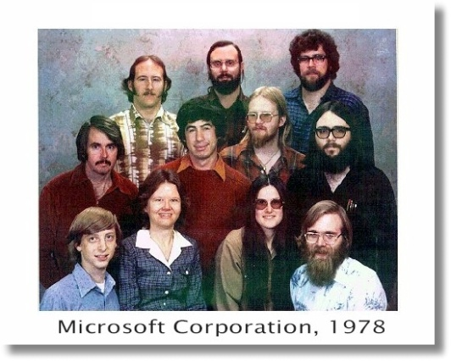
It’s not 1978… so stop acting like it.
Call PC Safety. Microsoft provides free virus and spyware removal support to Windows customers who think they have an infected computer or have other PC Security questions. Customers should call 1-866-PC Safety for phone support which is available 24 hours a day 7 days a week.
Windows Live OneCare Free Safety Scan
http://onecare.live.com/site/en-us/default.htm?s_cid=sah
Microsoft Malicious Software Removal Tool
http://www.microsoft.com/security/malwareremove/default.aspx
Applying the Principle of Least Privilege to User Accounts on Windows XP
http://technet.microsoft.com/en-us/library/bb456992.aspx
Applying the Principle of Least Privilege to Windows Vista
http://technet.microsoft.com/en-us/library/cc512618.aspx
Microsoft Security: 4 steps to protect your computer
http://www.microsoft.com/security/pypc.aspx
Microsoft Security Essentials
http://www.microsoft.com/security_essentials/
Top Tips for Internet Safety at Home
http://go.microsoft.com/?linkid=9686171
Microsoft Security: Watch out for fake virus alerts
http://www.microsoft.com/security/antivirus/rogue.aspx
Twenty Critical Controls for Effective Cyber Defense: Consensus Audit Guidelines
http://csis.org/files/publication/Twenty_Critical_Controls_for_Effective_Cyber_Defense_CAG.pdf
The Top Cyber Security Risks
http://www.sans.org/top-cyber-security-risks/

